Slide 1
Two Trains and Fly
Two trains are on the same track a distance 100 mi apart heading towards one another, each at a speed of 10 mi/h.
A fly starting out at the front of one train, flies towards the other at a speed of 20 mi/h.
Upon reaching the other train, the fly turns around and continues towards the first train.
How many kilometers does the fly travel before getting squashed in the collision of the two trains?
http://mathworld.wolfram.com/TwoTrainsPuzzle.html

Slide 2
Two Trains and Fly

Slide 3
Two Trains and Fly

Slide 4
Vector

Slide 5



Vector in Coordinate

Slide 6

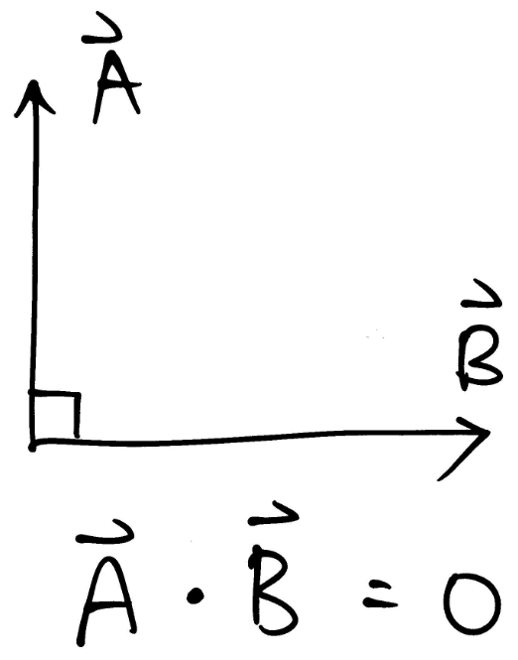
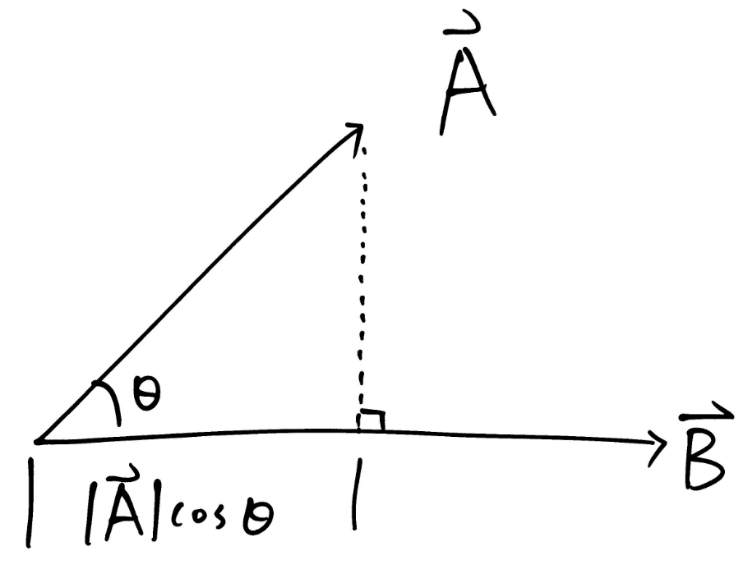
Inner Product

Slide 7
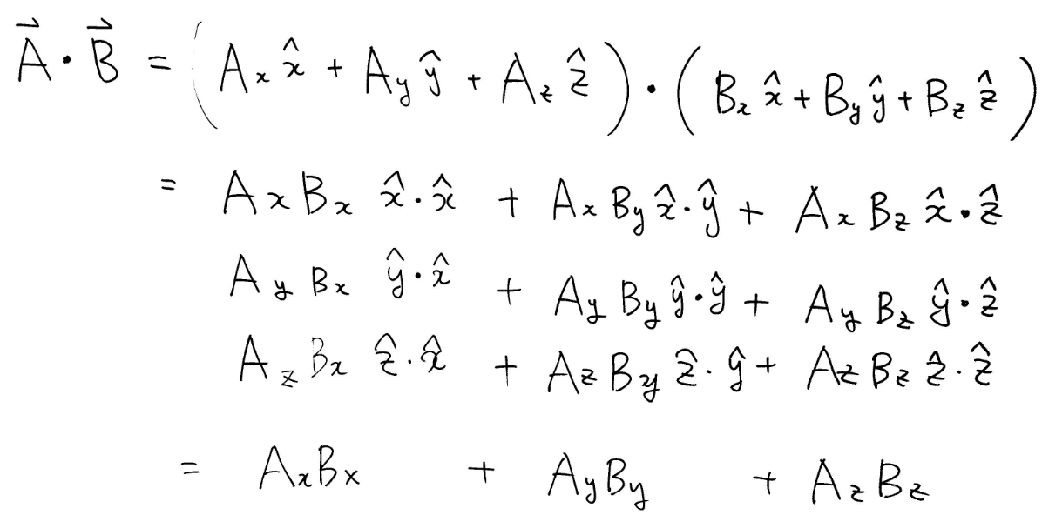
Inner Product

Slide 8
Translational Motion

Slide 9

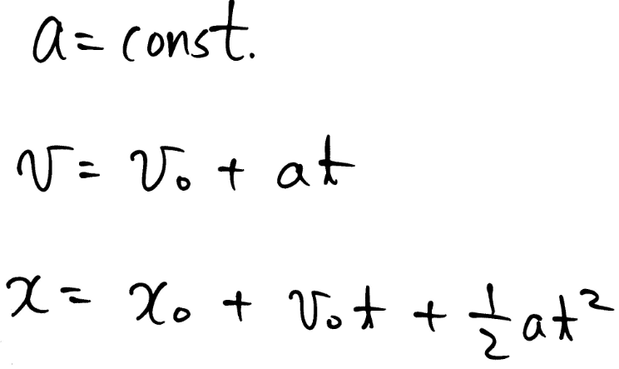
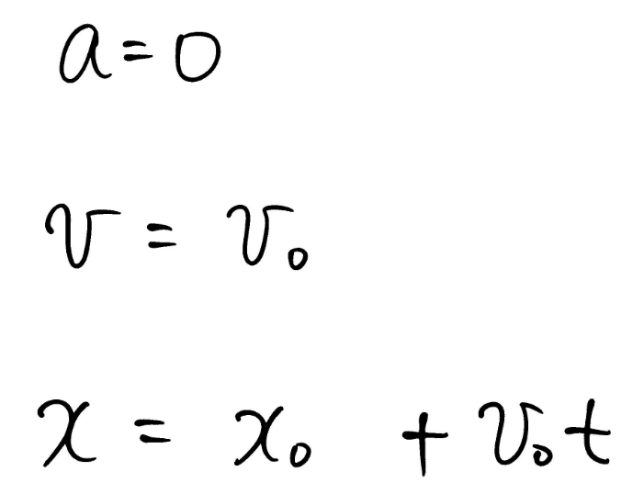
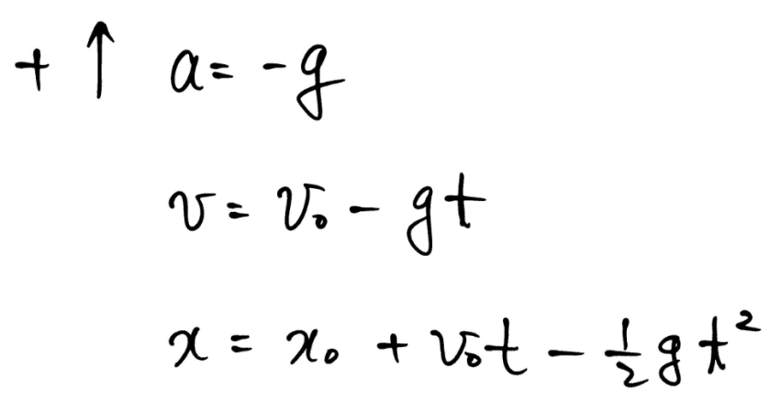

Kinematics in 1-D

Slide 10
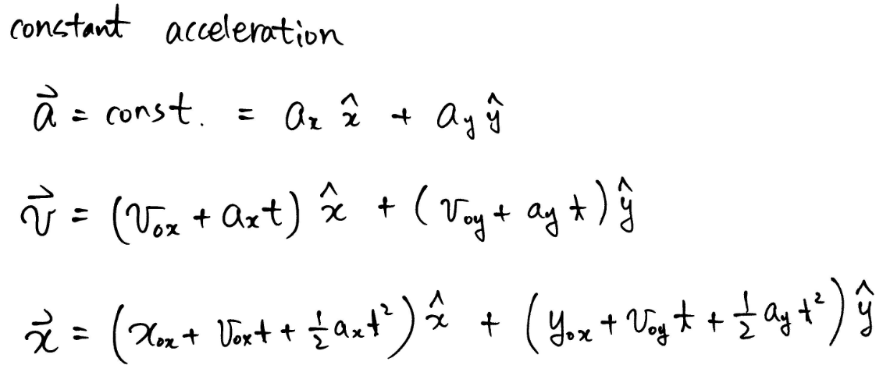

Kinematics in 2-D

Slide 11
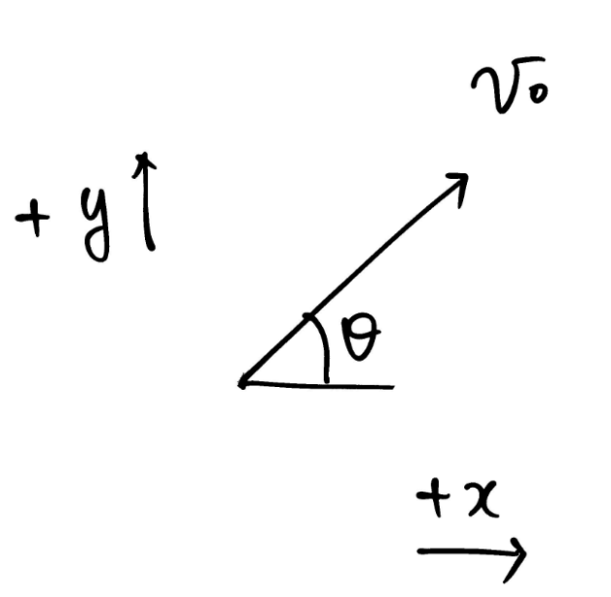
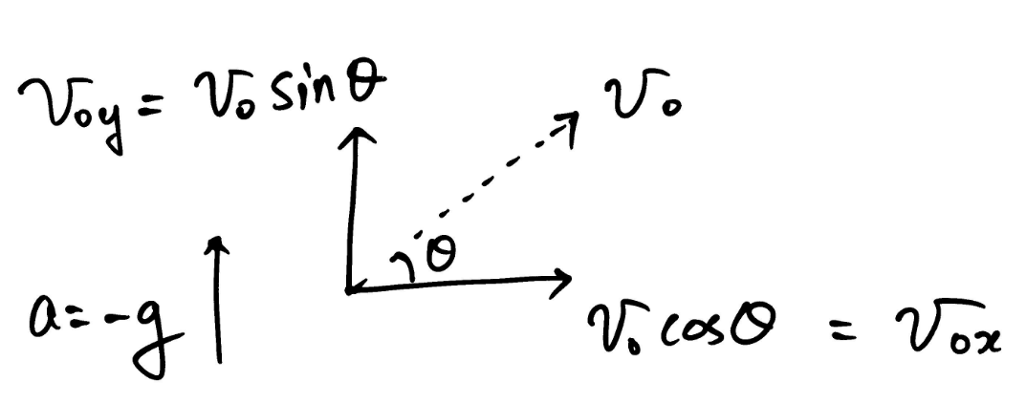

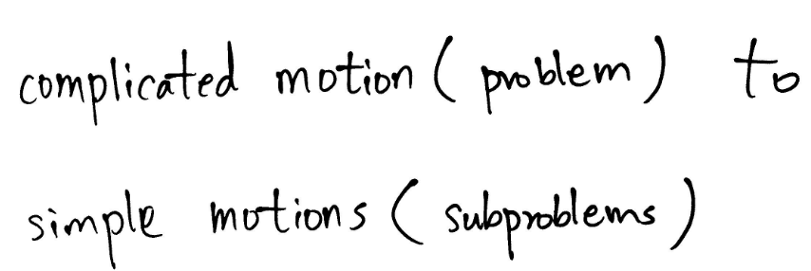
Decomposition in 2-D

Slide 12
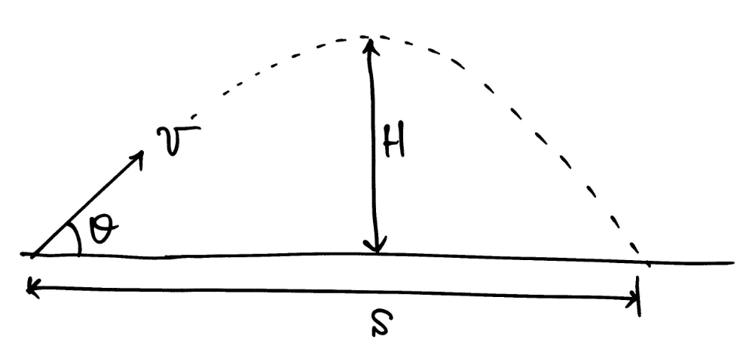
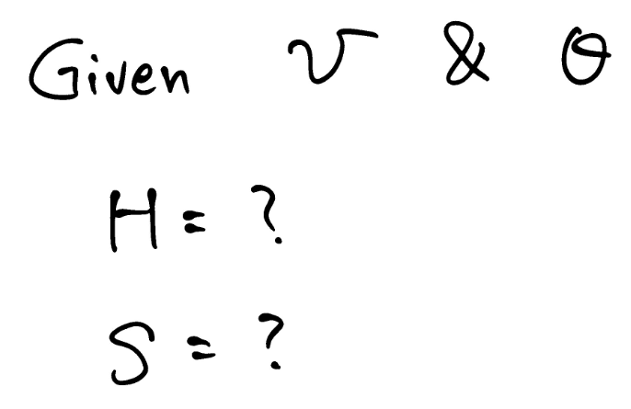

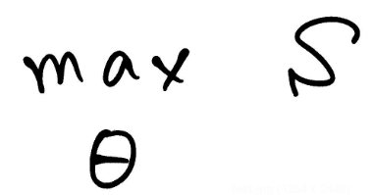
Projectile

Slide 13
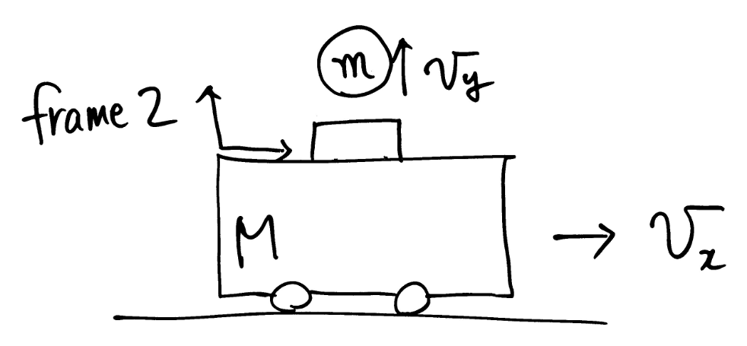
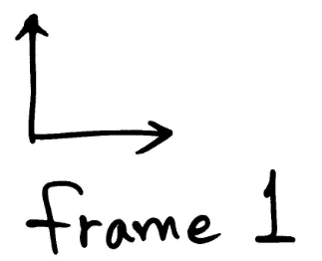

Different Frames

Slide 14
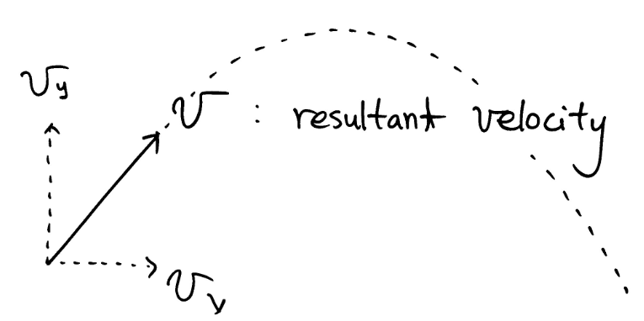

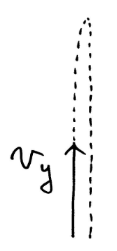

Different Frames

